Slide 1
Analysing the Impact of Car Features on Price and Profitability
Manan Yadav
yadavmanan1111@gmail.com

Slide 2
Table of contents
01
02
03
04
Approach
Project Description
Insights
Results

Slide 3
Project Description
In this project we needed to derive various insights into how various car features affect the price and profitability of the car. Various columns show different features and the relationship between the car's features, market category, and pricing, these are some features and categories which are most popular among consumers and most profitable for the manufacturer.
We needed to use different analysis techniques like regression analysis, market segmentation, correlation analysis, etc to get insights about the car and how the car performs in a given market. Using Pivot tables for insights and then for data visualization using different charts, then making an interactive dashboard using slicers and filters.

Slide 4
Approach
The approach was to first study and understand each column of the given dataset. Then select specific columns to find relationships between various parameters and derive insights from them.
After getting the insights, for data visualization then they are converted into charts from tables. So the insights are represented in a better way.

Slide 5
Tech-Stack used
Microsoft Excel
To perform analysis and converted the insights into charts and create a dashboard
Microsoft PowerPoint
For making the project presentation

Slide 6
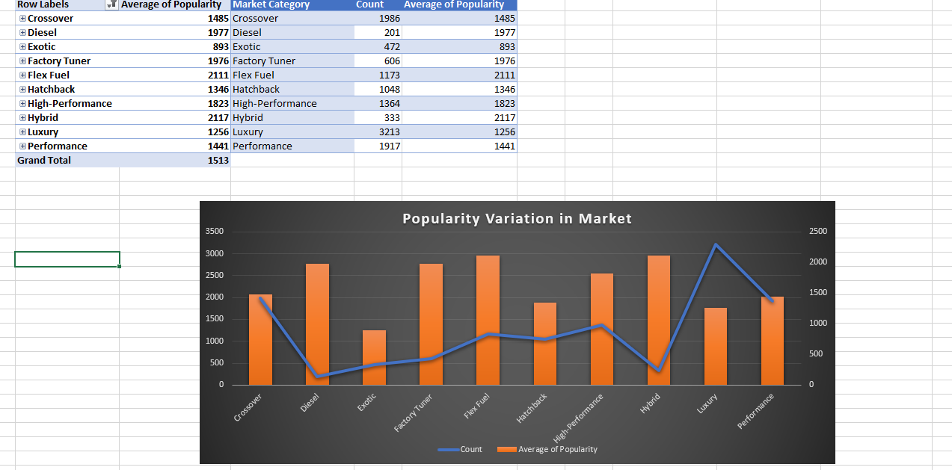
INSIGHTS
Task 1 : Relation between the popularity of a car model across different market categories

Slide 7
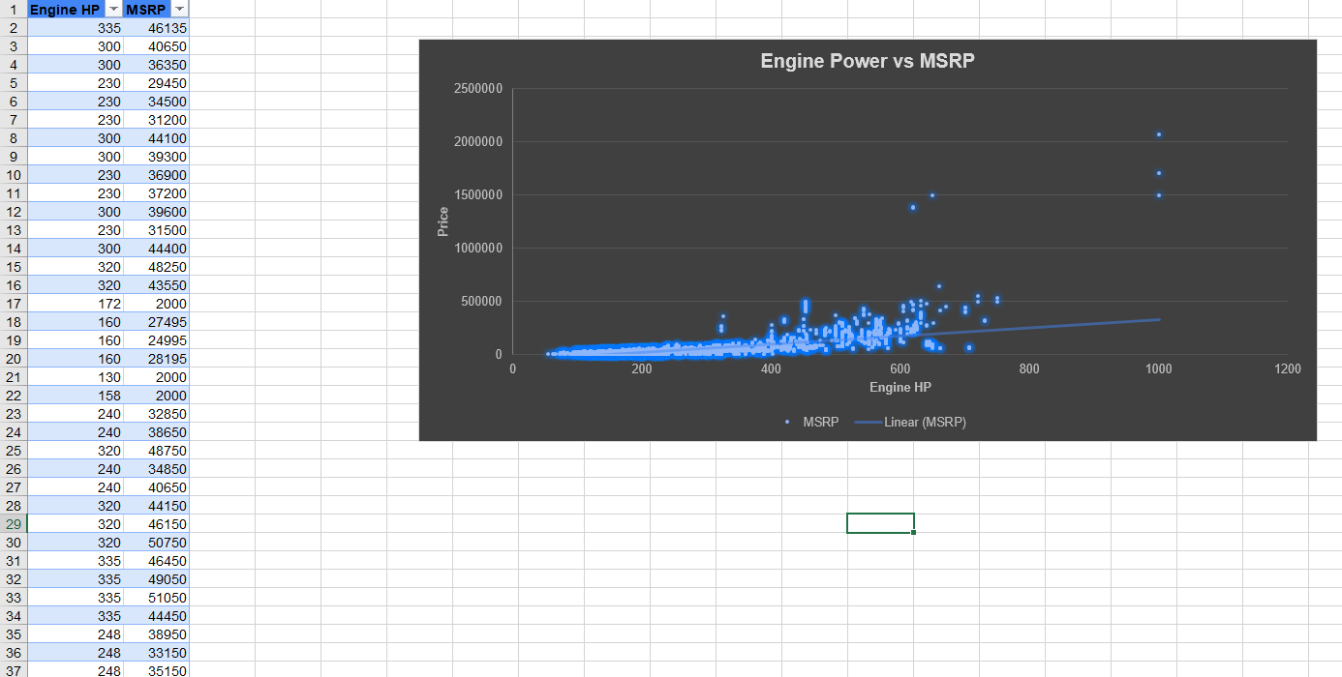
Insights
Task 2 :What is the relationship between a car's engine power and its price?

Slide 8
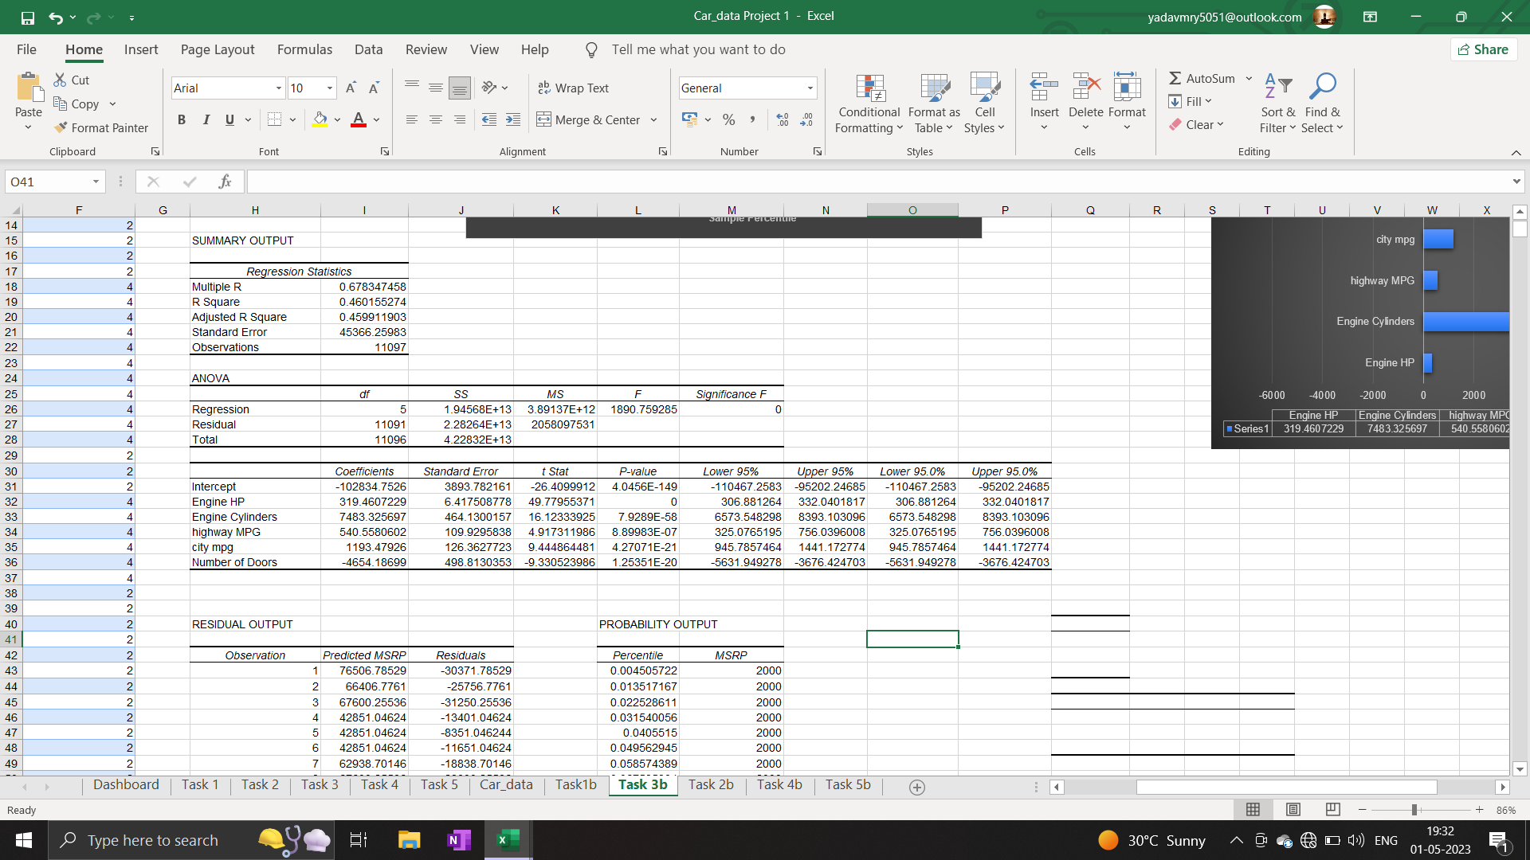
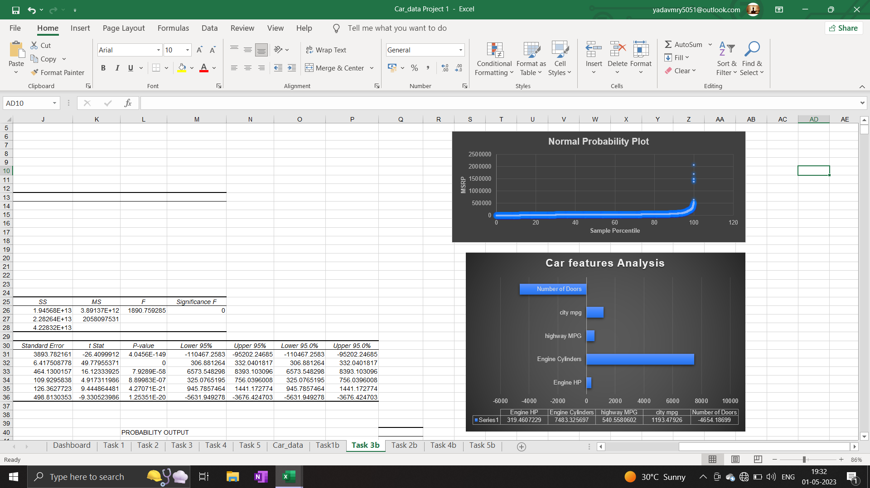
Insights
Task 3 : Which car features are most important in determining a car's price?

Slide 9
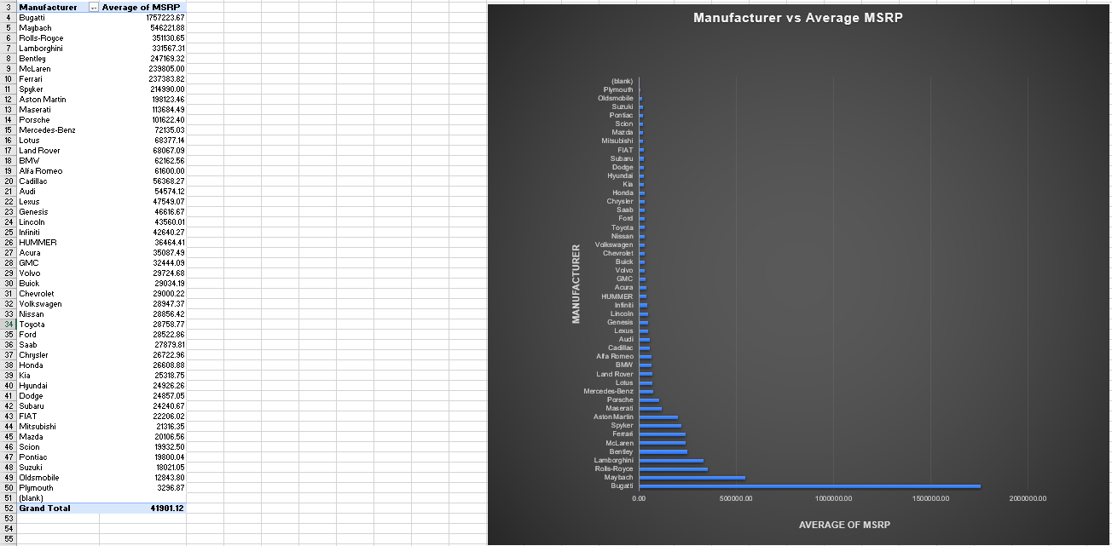
Insights
Task 4 : How does the average price of a car vary across different manufacturers?

Slide 10
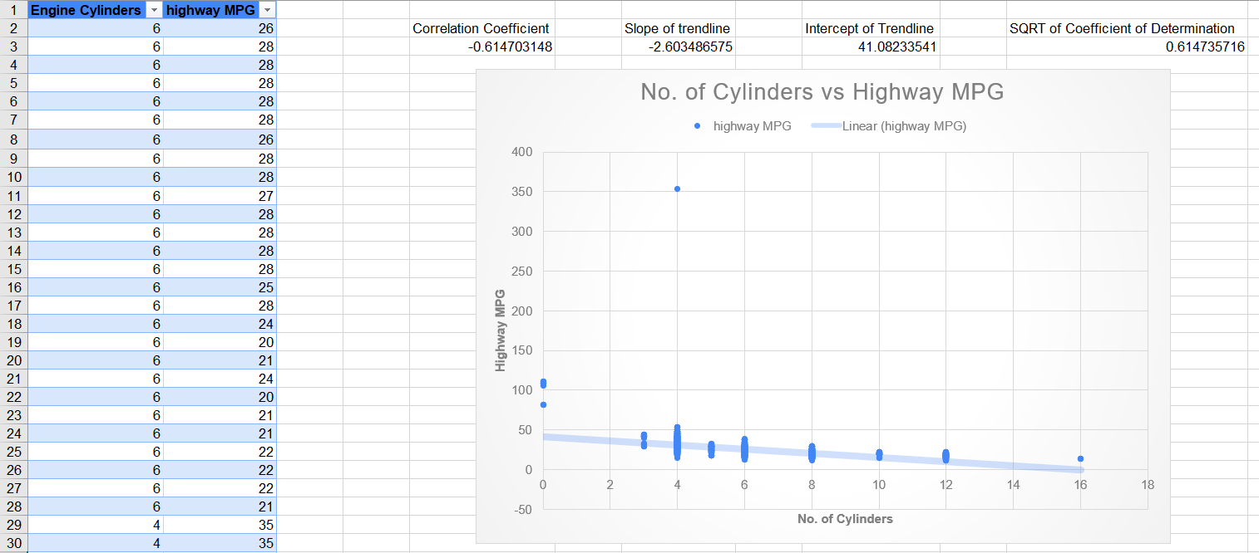
Insights
Task 5 : What is the relationship between fuel efficiency and the number of cylinders in a car's engine?

Slide 11
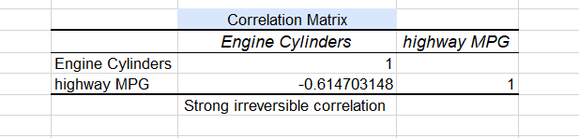
Insights
Task 5 : Below the correlation coefficient between the number of cylinders and highway MPG to quantify the strength and direction of the relationship.

Slide 12
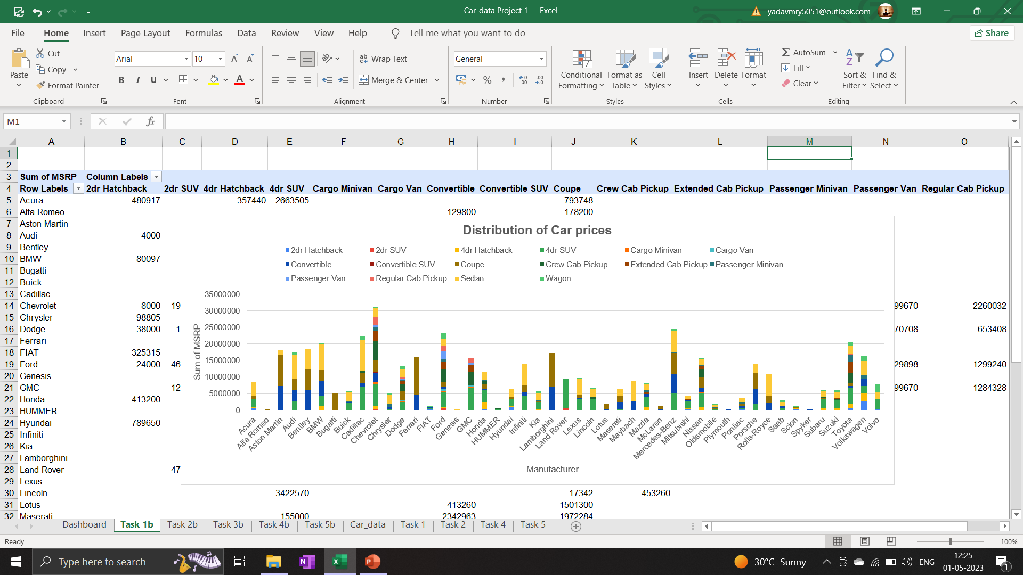
Insights
Task 1 : To find the distribution of Car prices over different Brands

Slide 13
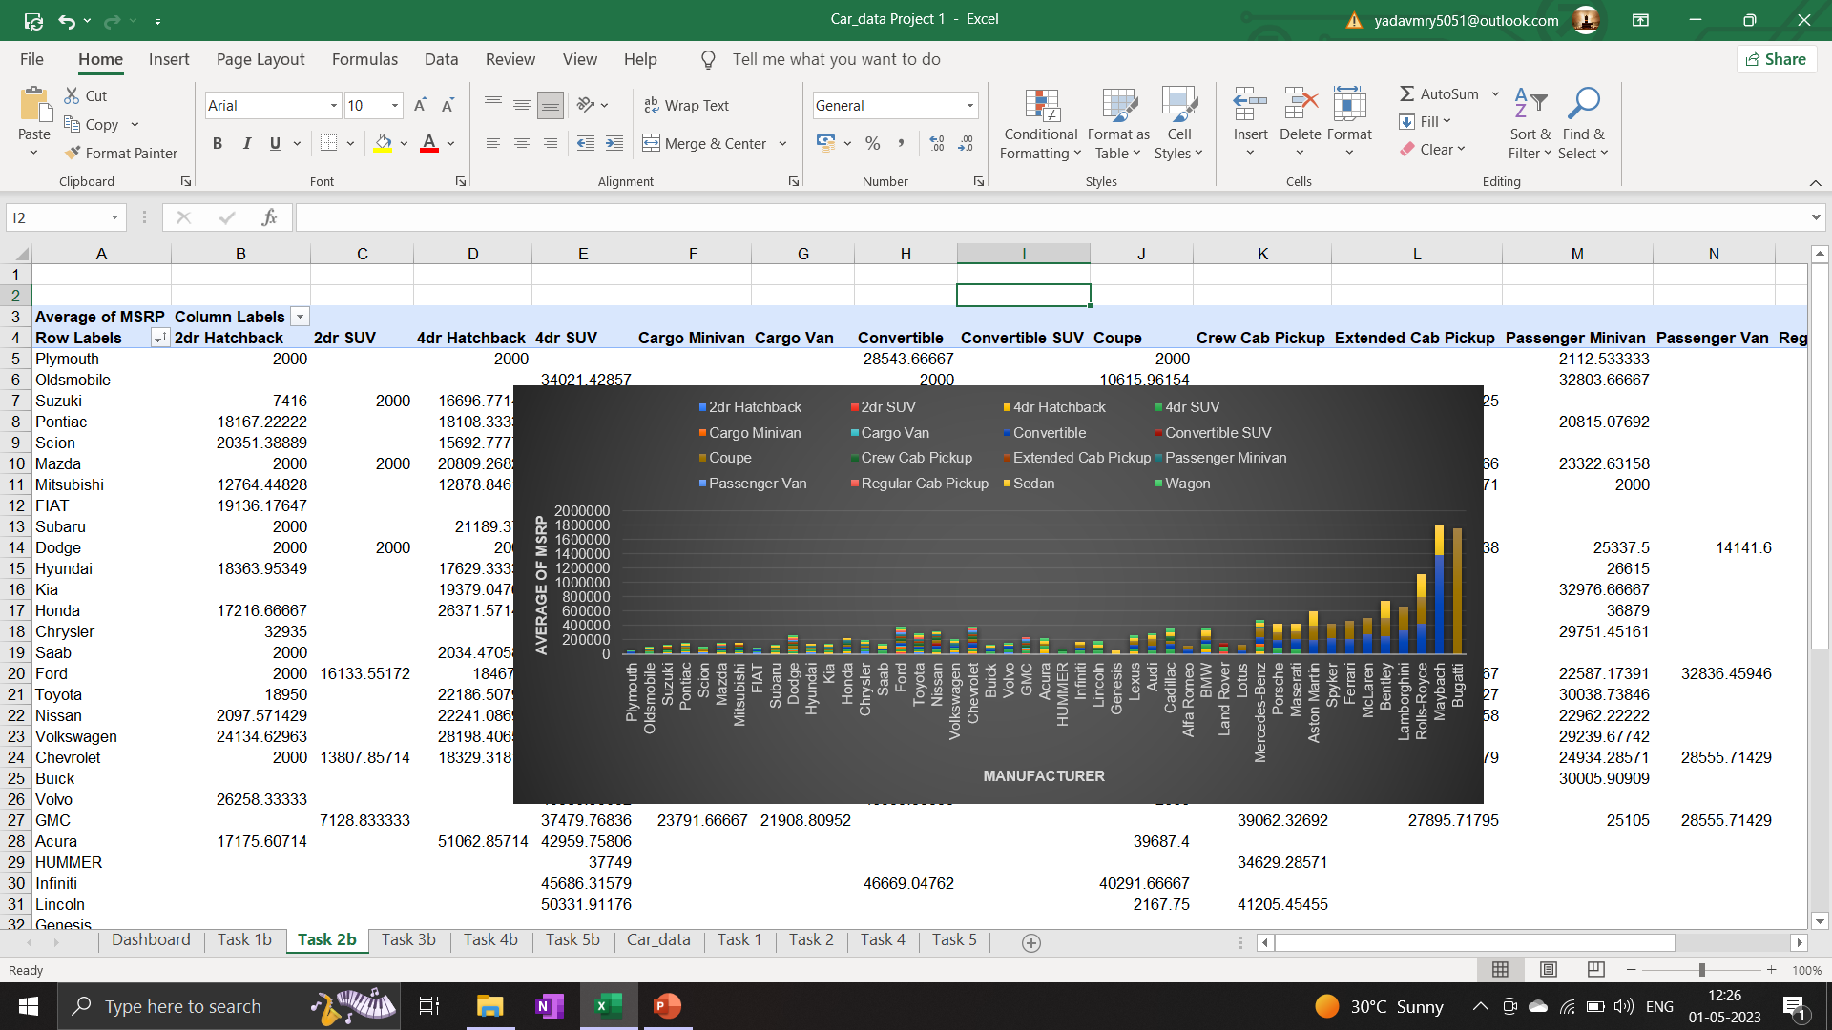
Insights
Task 2 : Which car brands have the highest and lowest average MSRPs, and how does this vary by body style?

Slide 14
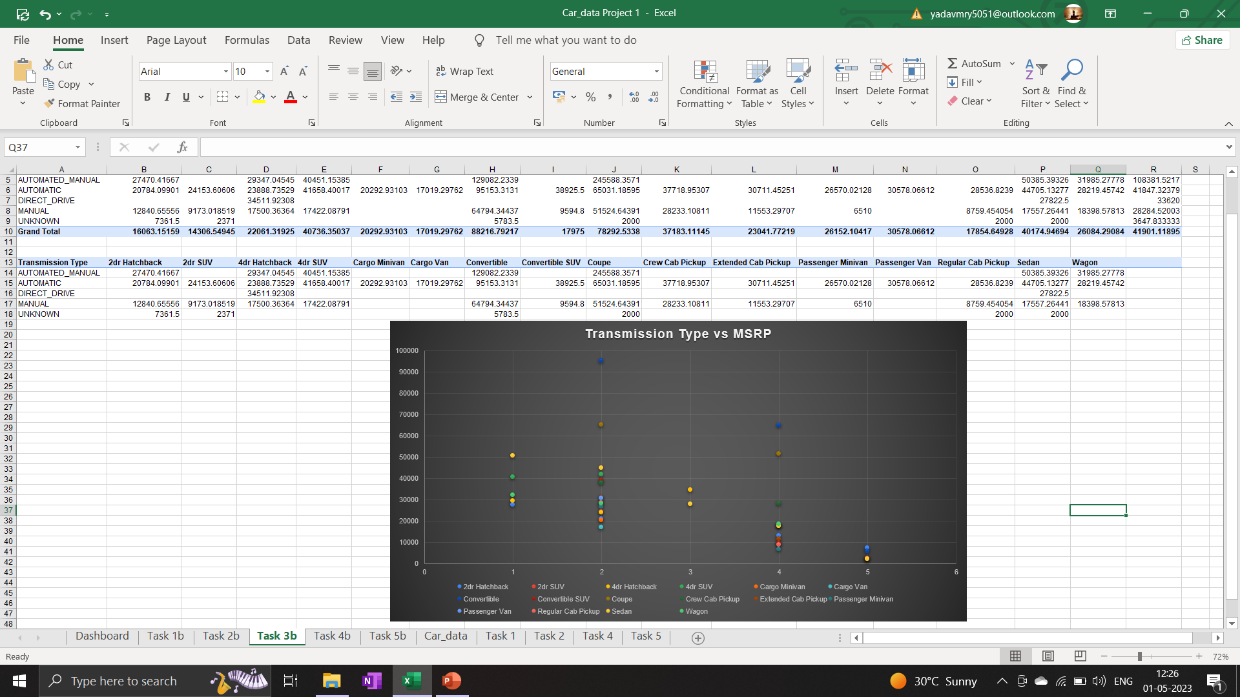
Insights
Task 3 : How do the different feature such as transmission type affect the MSRP, and how does this vary by body style?

Slide 15
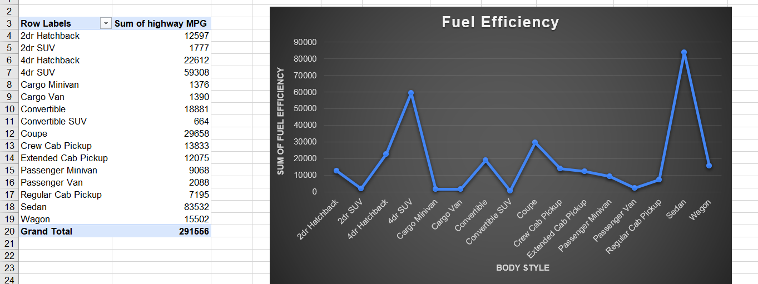
Insights
Task 4 : : How does the fuel efficiency of cars vary across different body styles and model years?

Slide 16
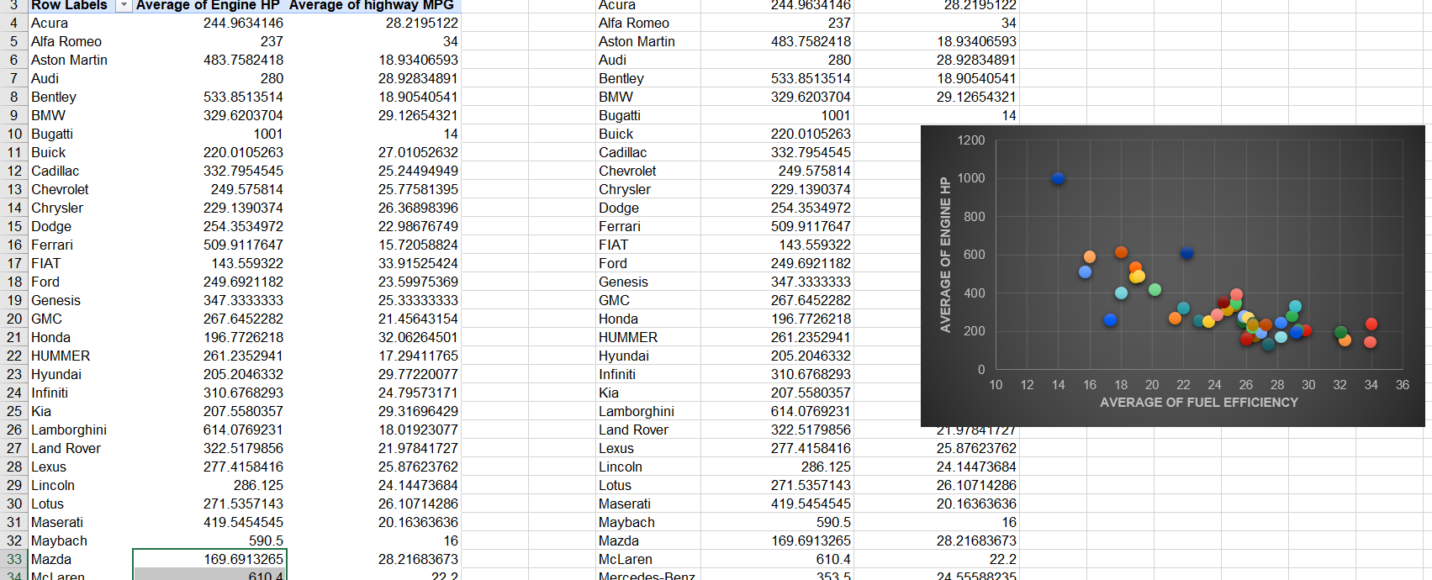
Insights
Task 5 : : How does the car's horsepower, MPG, and price vary across different Brands

Slide 17
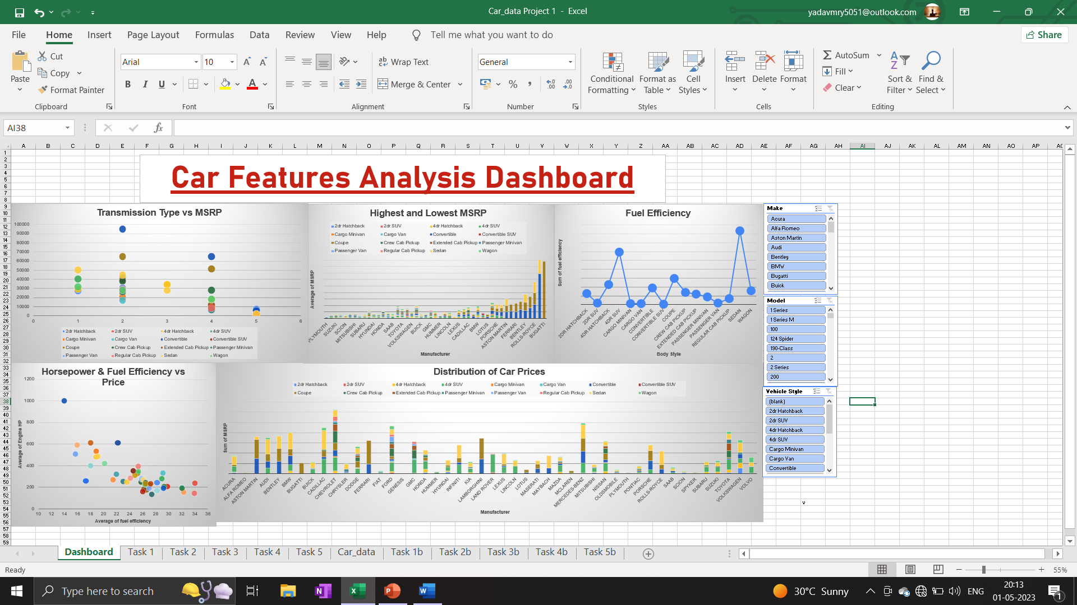
Dashboard

Slide 18
Results
Through this project, I learned how to use a powerful tool like Excel on a dataset to get useful insights. The many Excel functions make it easier for us to manipulate data from the data set and get various insights which can also be used for data visualization.
The hyperlink to the Analysis_File . (Open the file in Excel only and not Google Sheets)
The data visualization helped us to get a deeper understanding and a more appealing way to present the insights. By using different charts for different parameters and then building an interactive dashboard which presented all the insights from the data.

